Slide 1
Sizing a BroadVision Site
Our Little Secret

Slide 2
There is no secret to sizing
Every site is unique
Every application is different
Every implementation of BroadVision is done differently
A well designed site will perform better
A well implemented site will perform better

Slide 3
An Exercise in Sizing
Grandiose Plans, Inc.

Slide 4
Customer’s Assumptions on Site Traffic
56 million hits/day
470,000 visits/day
3.5M pages viewed/day
8,400 concurrent users @ peak hour
Extrapolation: 16 = average number of hits/page (56M hits/day divided by 3.5M pages viewed/day)

Slide 5
Use Concurrent User @ Peak Time
If we can get this number, we can continue the initial sizing estimate

Slide 6
8,400 Concurrent Users at Peak
16,800 pages/minute
  Rule of thumb: viewer looks at page for 30 seconds
1,008,000 pages/hour (16,800 * 60 minutes)
10 million pages viewed/day
  Rule of thumb: 40% of site traffic occurs in 4 hour period
  1M pages/hour at peak = 4M pages during 4 hour peak, represents 40%, 6M pages for the rest of the day.
160,000,000 hits/day
  10M pages/day * 16, average number of hits/page

Slide 7
“160,000,000 hits/day is large by industry standards”

Slide 8
What’s the point?
It is important to help the client understand what their site can reasonably expect to accomplish
Double check the numbers!

Slide 9
Pages viewed / day
With this number, we can also calculate the estimated size

Slide 10
Using Pages Viewed/Day
3.5M pages viewed/day
350,000 pages/viewed in the peak hour
98 pages/second (350K / (60 * 60))
49 dynamic pages/second (50% of pages are static)
6 CPU’s (49 pages/second divided by 8 pages/second/CPU)
9 CPU’s at 70% CPU utilization required (BroadVision recommends 70%)

Slide 11
What’s the Point?
Customer had some numbers that made sense, we just had to double check them
This is a starting point, this needs to be validated throughout the development process

Slide 12
Q & A Sizing a BroadVision Site

Slide 13
Staffing a BroadVision Project
The Right Team with the Right Skills

Slide 14
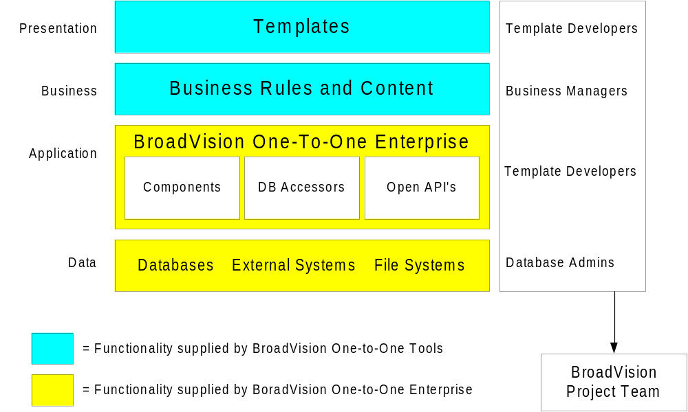
Recommended BroadVision Project Team

Slide 15
Template Developers
Necessary skills:
  HTML
  Server-side JavaScript
  Unix or Windows/NT fundamentals
  Basic DB knowledge
  Client-side JavaScript
BroadVision Training: AppDev1

Slide 16
Business Managers
Necessary skills:
  Business goals and metrics
  Communities
  Content workflow
  Establish matching rules
BroadVision training:
  BMGR1
  BMGR2

Slide 17
Application Developers
Necessary skills:
  Server-side JavaScript, BroadVision hooks
  C++ (if building BroadVision components)
  Corba (if building BroadVision services)
BroadVision training: AppDev1
  AppDev2 - Advanced JavaScript’ing
  AppDev2 - Component writing
  AppDev2 - Performance tuning

Slide 18
System Administrators
Necessary skills:
  Database administrator
  Operating system
  HTTP server
  Networking, firewall
BroadVision training:
  AppDev1
  AppDev2 - System administration
  AppDev2 - Performance tuning

Slide 19
Client Readiness
Business/Marketing Manager
  Storyboard (look & feel)
  Business rules
  Communities
Content publishers: introduce new content to the site
Content managers/editors: ensure quality of the content
Channel managers: introduce content to specific channel (4.1 Knowledge)

Slide 20
Client Readiness (continued)
Creative talent: create the layouts and graphics, the visual appeal of the site
Technical skills:
  HTML
  Server- (and maybe client-) side JavaScript
  C++ (if necessary)
  OS, DB, network, HTTP admin skills (described earlier)

Slide 21
Scoping a BroadVision Project
Initial Estimates for Common Tasks (Estimates based on BroadVision consultants)

Slide 22
JavaScript’ing
Rules of thumb for developing JavaScripts:
  Difficult: 3 days
  Moderate: 2 days
  Easy: 1 day
How to determine the # of JavaScripts
  Analyze current site
  Walk through high-level storyboard
  Diagram a potential look & feel
Learning curve: estimate 4 days for first easy-moderate script

Slide 23
Integration with Existing Web Apps
Frames: no extra time
Cookies: no extra time
URL exchange: 1 week design, 2 weeks implementation
API’s: 1 week design, 4 weeks implementation
Closed apps: 1 - 2 weeks design, 4 - 6 weeks integration
Testing will take much longer as soon as C++ enters the picture, 3 - 4 weeks to purify.

Slide 24
Integrate with Existing Databases
Sybase/Oracle/Informix: 1 week (CORBA servers out-of-box)
Proprietary DB with API set:
  1 week design
  3 weeks integration
  2 weeks to test
Proprietary DB without API set:
  1 week design
  6 weeks integration
  2 weeks to test

Slide 25
Estimating Reporting Requirements
Determine site reporting requirements: 3 days
BroadVision observations:
  Implement: 1 week
  Each report: 2 days
  Test: 3 days
Andromedia:
  Set up Aria: 1 week
  Implement solution: 1 week
  Test: 1 week

Slide 26
Commerce Specific Scoping
Will you be selling hard goods or soft goods?
  Soft goods:
    Software: need ESD solution (Preview Systems)
    Tips, editorials, articles: BroadVision microtransactions
  Hard goods: books, computers, donuts, etc.
Minimum time to implement commerce solution is approximately 6 weeks, getting quicker

Slide 27
Commerce Handlers: Shipping & Tax
Shipping:
  BroadVision out-of-the-box: 1 week
  Custom solution: 3 - 6 weeks, must have detailed design first
Tax:
  BroadVision out-of-the-box, using TaxWare: 3 weeks (design, implement, test)
  International extension: 2 weeks
  Address validation: 1 week
  Audit: 1 week
  Tax exceptions: 2 weeks

Slide 28
Commerce Handlers: Payment
Payment:
  BroadVision out-of-the-box, using Cybersource (asynchronous): 1 week
  Real-time custom solution: 4 - 6 weeks
  Recurring payments/subscriptions: 4 - 6 weeks
The following payment functionality is included:
  Authorization
  Settlement
  Fraud detection

Slide 29
Commerce Handlers: Fulfillment
Fulfillment:
  FTP orders to fulfillment house: 2 weeks
  Integrate with back-end inventory system
    Design: 1 week
    Implement: 2 - 4 weeks
    Test: 1 - 2 weeks
  Integrate with EDI packages
    Design: 2 weeks
    For each vendor: 1 week
    Per document to implement: 2 days
    XML: design and define as required

Slide 30
Commerce Handlers: Fulfillment (cont’d)
Fulfillment:
  Integration with ERP or accounting system
    Batch out: 2 weeks
    Batch in/out: 2 weeks
    Tight integration: 6 - 8 weeks
      Is the PO valid?
      Can this person charge to this PO?
  Single order multiple ship-to’s: 1 week
  Single order multiple shipping options: 1 week
  Returns supported: 3 days
  Multiple returns supported: 8 days

